Slide 1
Marketing Research, Analysis and Networking
at Zeus Numerix Private Limited, Pune.
PROJECT BY:
Gauranshi Chopra
20190301107
APRIL 2022

Slide 2

Table of Contents
01
INTRODUCTION
02
COMPANY PROFILE
03
METHODOLOGY AND ANALYSIS
04
FINDINGS
05
LIMITATIONS OF PROJECT
06
CONCLUSION
07
OBSERVATIONS & LEARNING FROM THE PROJECT
1

Slide 3



INTRODUCTION

Slide 4

|BACKGROUND OF STUDY
Market Research
Market Analysis
Market Networking
Design in Marketing
It involves collecting information from the market to help businesses understand the market they are operating in, the products they offer, and the customers they need to serve.
It involves gathering and analyzing market data to gain a better understanding of the market.
Market networking is a term used to describe a variety of different ways to interact with people in the industry, to build relationships and find new business.
Using design to build relationships, increase brand awareness, and drive sales.
2

Slide 5



| INDUSTRY PROFILE
Technology
Industry Participants
04
03
02
01
Futuristic Goal
Recent Industry Trends
3

Slide 6

COMPANY PROFILE

Slide 7

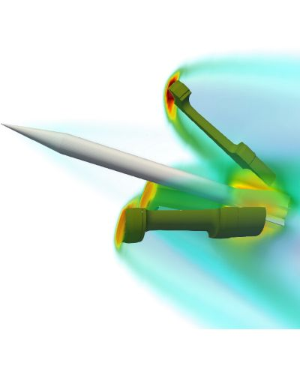
Founded in 2004, Zeus Numerix is the first company in India to develop a numerical analysis software.
The company offers design, analysis and certification solutions to their clients with the transfer of know-why.
Having completed 450+ projects and developed 35+ engineering software, Zeus Numerix has served 100+ customers.
4

Slide 8




| COMPANY VISION AND MISSION
To be the global benchmark for analysis, design and development of cutting-edge technologies for Defence and Aerospace, and to leverage this expertise for the betterment of society.
| COMPANY’S CORE COMPETENCIES
Build to specification
Strategic Software
Precision Guidance Systems
Aerospace and marine pumps
5

Slide 9

METHODOLOGY AND ANALYSIS

Slide 10






|OBJECTIVES OF THE PROJECT
Determine the current and potential market, as well as the needs and requirements, and assess the performance of current and future products and services of Zeus Numerix.
To research Zeus' marketing strategy and determine the most promising markets and segments to target.
To investigate the nature of market networking and its significance in modern marketing strategies, through the prism of a Defence Industry relationship.
6

Slide 11
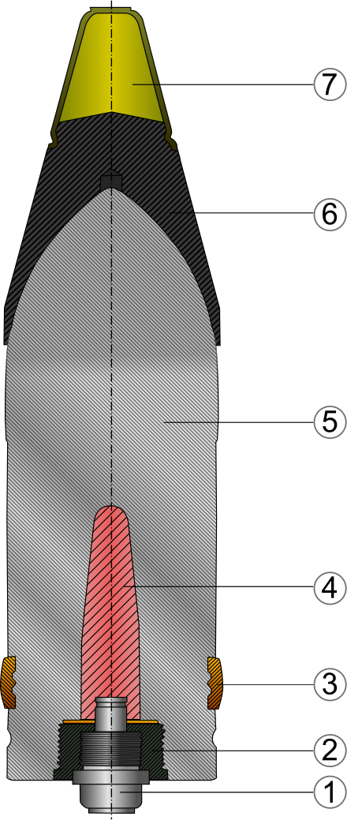
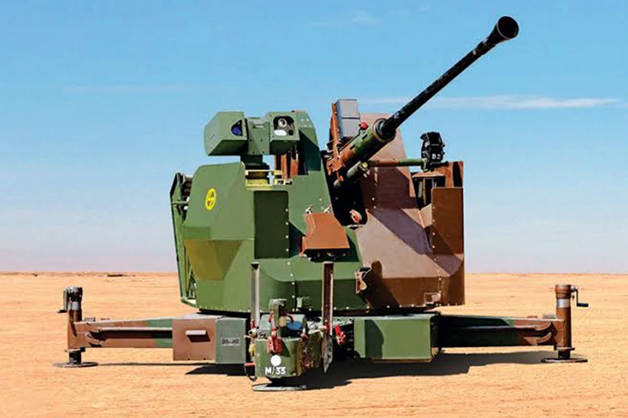
|INTRODUCTION TO PROXIMITY FUZE
Fuze : An electronic device designed to detonate an explosive charge in an artillery shell based on specific event.
Multi Option Fuze for Artillery (MOFA)
Proximity
Timer
Point Detonator
Delay
|SOURCE OF DATA COLLECTION
The primary sources of data will be primary and secondary market research conducted by the industry.
7

Slide 12
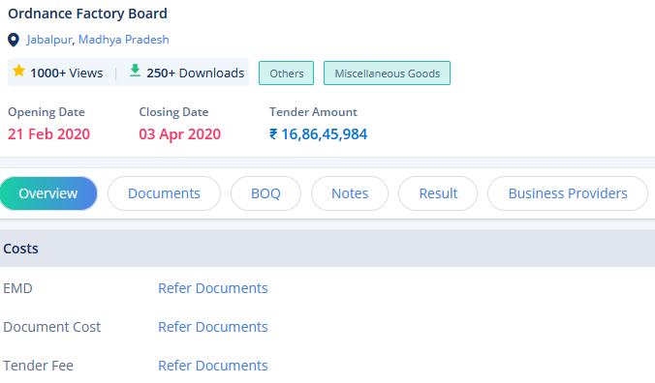
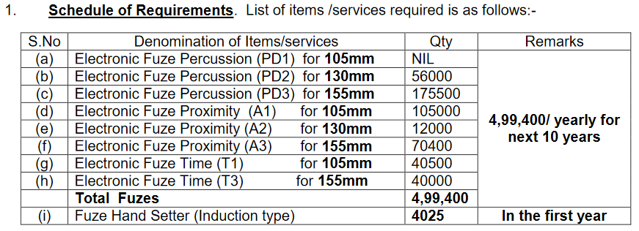
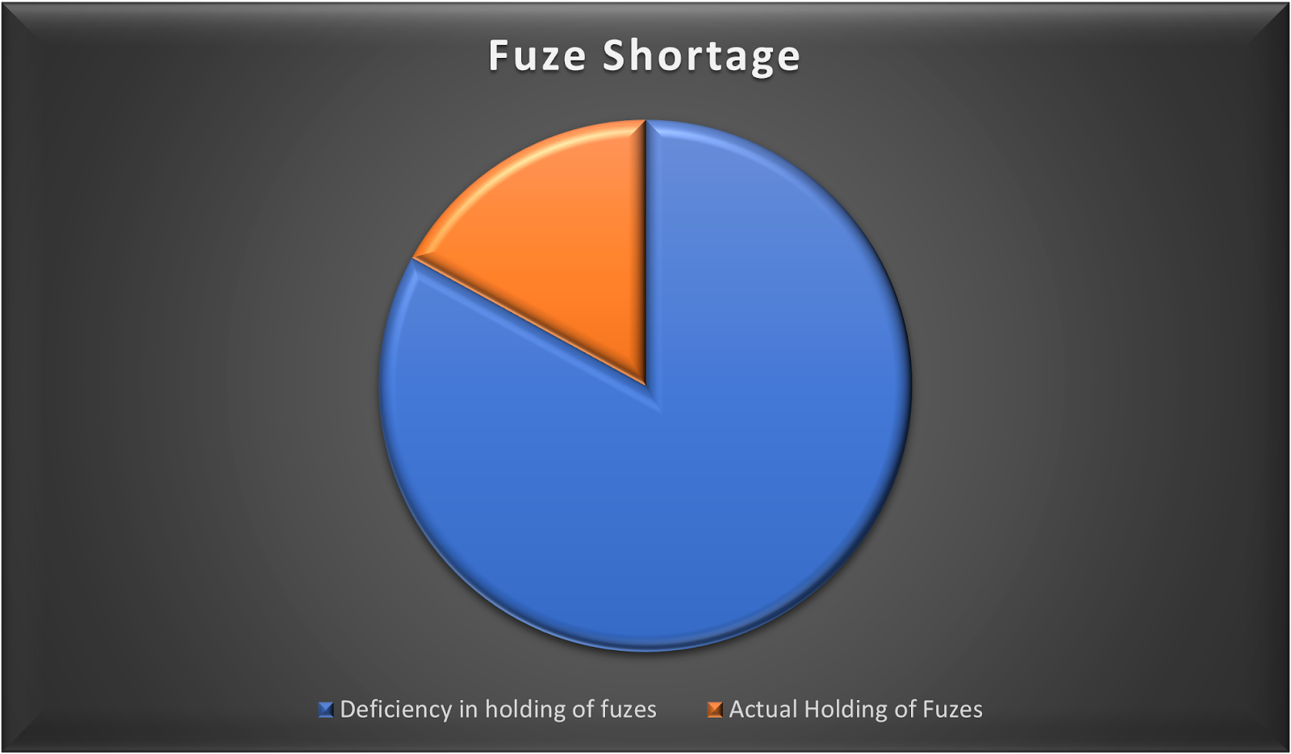
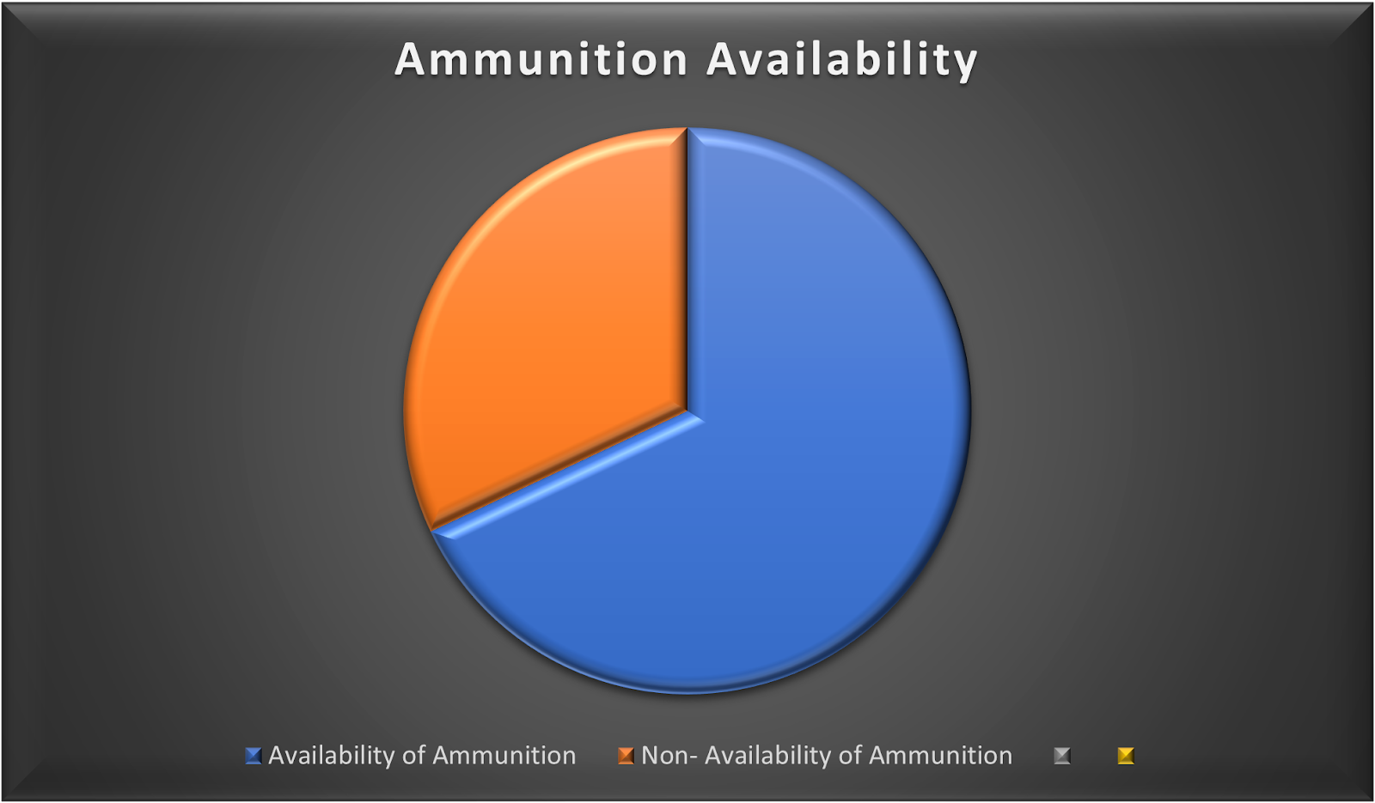
1. Tenders
2. Articles and Published Research Papers
8

Slide 13
|MARKET ANALYSIS
ALL PREDICTIONS ARE BASED ON ASSUMPTIONS WITH BASE VALUE PROVIDED BY OFB REQUIREMENTS
Year | Quantity | Market Growth Rate | Company Recurring Revenue/ Piece (in Rs.) | Increasing Revenue Expected Per Year (in Rs.)
2022 | 8000 | 5% | 10,000 | 8,00,00,000
2023 | 8400 | 5% | 10,000 | 8,40,00,000
2024 | 8820 | 5% | 10,000 | 8,82,00,000
2025 | 9261 | 5% | 10,000 | 9,26,10,000
2026 | 9724.05 | 5% | 10,000 | 9,72,40,500
TOTAL |  |  |  | 44,20,50,500
9

Slide 14






|COMPETITION AND COLLABORATION
In the case of this market study, it suggests that the competition will also be a potential collaboration for production of MOFA.
Electronics Corporation of India Limited
Hindustan Aeronautics Limited
01
02
Ordnance Factories Board
Bharat Electronics Limited
03
04
05
ASTRA Microwave
06
VEM Technologies
10

Slide 15

|MARKET NETWORKING
CATEGORIZATION OF ORGANIZATION | NUMBER OF ORGANIZATIONS REGISTERED
Start- Up | 110
MSME | 84
Academia | 10
Large Companies | 17
Consultant | 14
Financial Institution | 4
TOTAL | 239
11

Slide 16

LIMITATIONS & CONCLUSION

Slide 17
|MARKET GAP PROBLEMS
Expired and archived tender research difficulty
Technology Moat-
0 or 1 Product
Trial Rigs Unavailability
Cross Usability issues
Electronic Fuze is very expensive thus Army prefers mechanical
MOFA is not available in India. Too much dependency on foreign vendors.
12

Slide 18
|CONCLUSION
Tender acceptance rate of Zeus Numerix is 10%.
Shift from mechanical to electronic fuzes
Infrastructure unavailability for trial rigs
Research and analysis plays an important role in marketing
Majority of projects rely on collaboration
13

Slide 19
OBSERVATIONS & LEARNINGS

Slide 20

|OBSERVATIONS & LEARNINGS
Every product requires a deep study and knowledge
SUGGESTIONS
Graphical depiction, statistical analysis, and data analysis
First mover advantage
Pursuing marketing as a career
Cross Usability of Goods
Market networking is a crucial aspect of business
14

